Slide 1
Longitudinal Impact of Prostate Cancer Treatments on EQ-5D
Ahmed Mokhtar

Slide 2

Introduction & Objectives
Prostate cancer occurs in the prostate, a small gland that produces seminal fluid. Can spread.
1 in 8 men will develop prostate cancer in their lives. 1 in 30 will die from it. Most common cancer in men.
Treatments
Objectives
Radiation | High energy rays used to kill cancer cells
Prostatec-tomy | Surgical procedure to remove prostate gland
Adrogen Deprivation Therapy (ADT) | Lower levels of hormones that cancer cell rely on for growth
Impact of Treatments on EQ5D Utility Scores Over Time
Differences in Health Utility Change Between Timepoints
Effects of Treatment Interactions on EQ-5D
Sonny Schelin, Mikael Madsen, Elisabeth Palmqvist, Erik Mäkelä, Claes Klintenberg & Gunnar Aus. (2009) Long-term follow-up after triple treatment of prostate cancer stage pT3. Scandinavian Journal of Urology and Nephrology 43:3, pages 186-191.
Canadian Cancer Society. (2024) Prostate Cancer Statistics. Cancer.ca. https://cancer.ca/en/cancer-information/cancer-types/prostate/statistics#:~:text=It%20is%20estimated%20that%20about,30%20will%20die%20from%20it.

Slide 3
Methods
Literature Search
Data Cleaning & Restructuring
EDA
missForest Classification Imputation
Excluded sporg, spbone, chemo. Lack of variability.
Long form data
Random-Intercept Model
Model Assumption Checks
Kruskal-Wallis Test
Residual Maximum Likelihood
Followed by Dunn’s Test

Slide 4
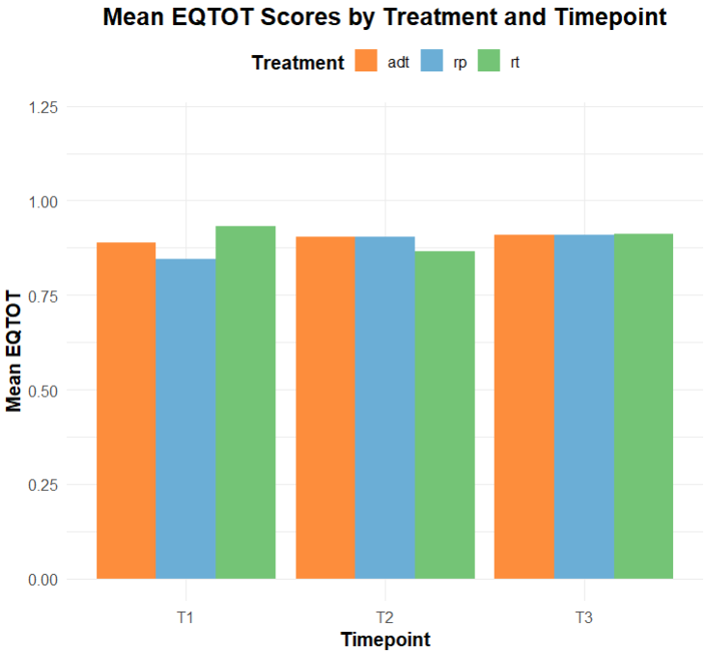
Preliminary Evaluation of EQ-5D Scores
Figure 1: Mean EQTOT Scores by Treatment and Timepoint

Slide 5
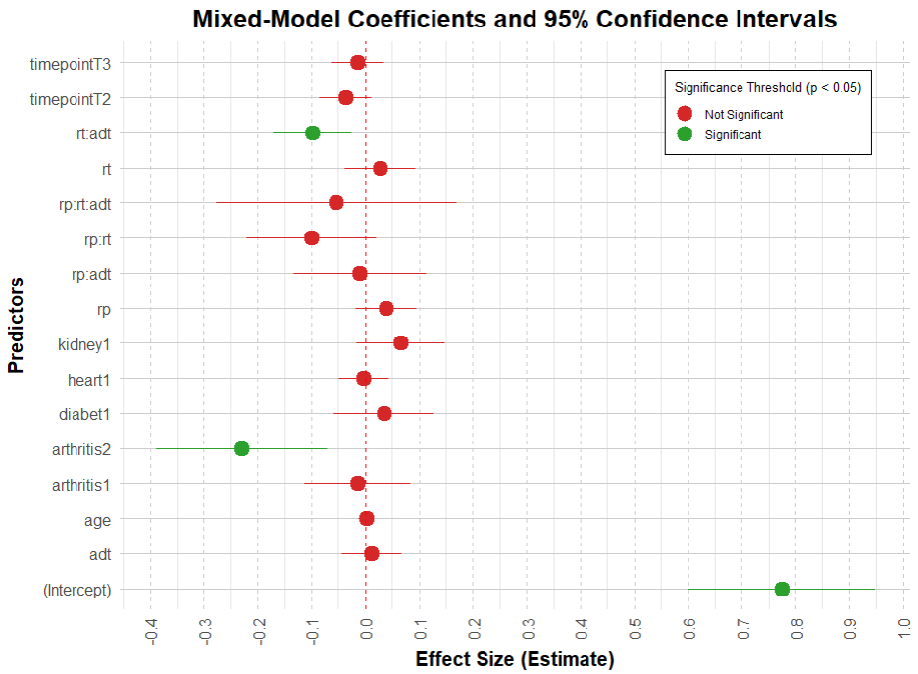
Random Intercept Model
model <- lmer( eqtot ~ rp * rt * adt + age + timepoint + diabet + kidney + heart + arthritis + (1 | ptid)
Fixed effects:
Age, timepoint, comorbidities
Treatments (and interactions)
Random effects:
Patient ID
ptid variance = 0.00691
Residual variance: 0.01488
Assumptions Violated:
Linearity
Normality of residuals
Homoscedasticity
Random effects normality
Figure 2: Model Coefficient Plot
Notes:
Sheri L. Maddigan, Feeny, D. H., & Johnson, J. A. (2005). Health-Related Quality of Life Deficits Associated with Diabetes and Comorbidities in a Canadian National Population Health Survey. Quality of Life Research, 14(5), 1311–1320. https://doi.org/10.1007/s11136-004-6640-4
Smith, D. P., King, M. T., Egger, S., Berry, M. P., Stricker, P. D., Cozzi, P., Ward, J., O’Connell, D. L., & Armstrong, B. K. (2009). Quality of life three years after diagnosis of localised prostate cancer: population based cohort study. BMJ, 339(7739), 195–195. https://doi.org/10.1136/bmj.b4817
Benzo, R.M., Moreno, P.I., Fox, R.S. et al. Comorbidity burden and health-related quality of life in men with advanced prostate cancer. Support Care Cancer 31, 496 (2023). https://doi.org/10.1007/s00520-023-07962-6

Slide 6
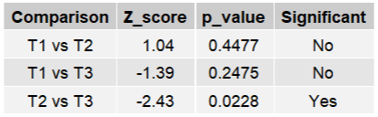
Results and Discussion
Kruskal-Wallis test
Discussion
kw <- kruskal.test(qol_change ~ timepoint, data = combined_df_clean_imputed)
The combined treatment of radiation and hormone therapy decreases EQTOT by approximately 10% when all other variables are at zero or reference level.
Failed assumption invalidate results of model.
Statistically significant increase in EQ-5D change between T2 and T3.
QOL change is normally distributed, but Levene’s test indicates significant difference in variances (p = 2e-16)
p = 0.05
Change in distributions of EQ-5D score is statistically different across timepoints.
Limitations
Dunn’s Test
Bonferroni corrected
Bonferroni correction too conservative, increases likelihood of Type II error.
Lack of clear standard procedure with treatment times, and defining diagnosis stage.

Slide 7
Appendix

Slide 8
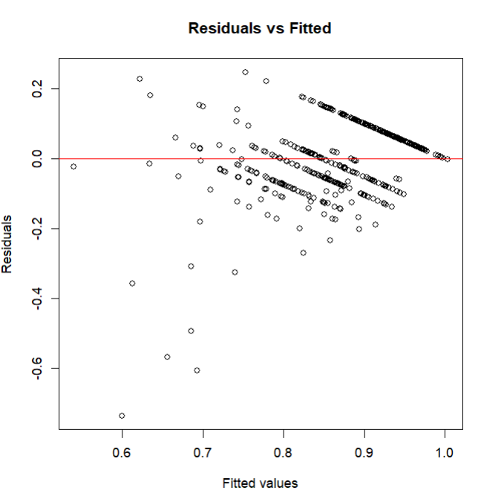
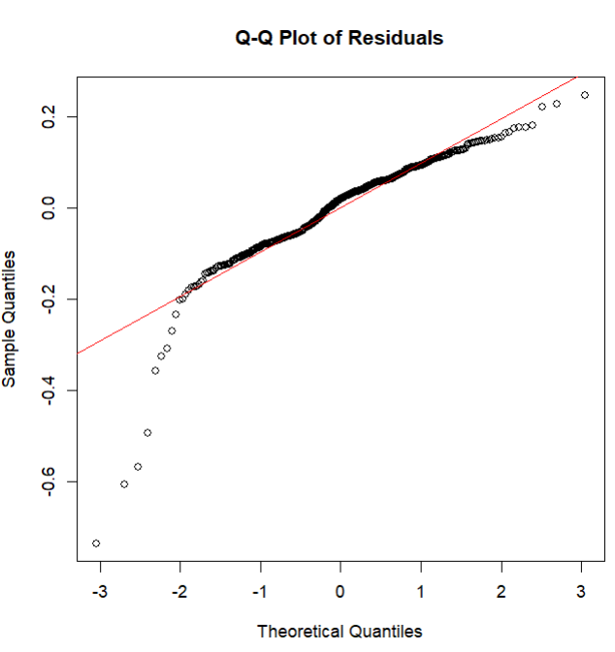
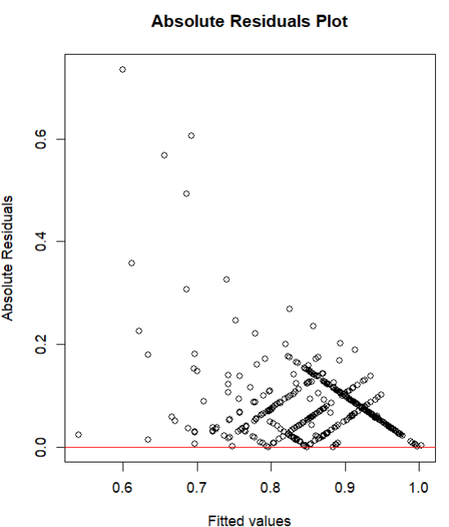
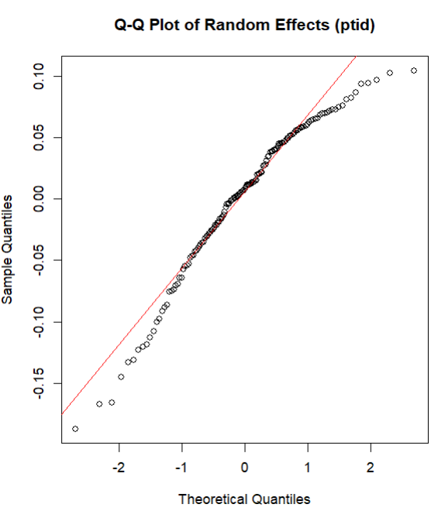
Linearity
Normality of Residuals
Homoscedasticity
(constant variance)
Random Effects Normality

Slide 9
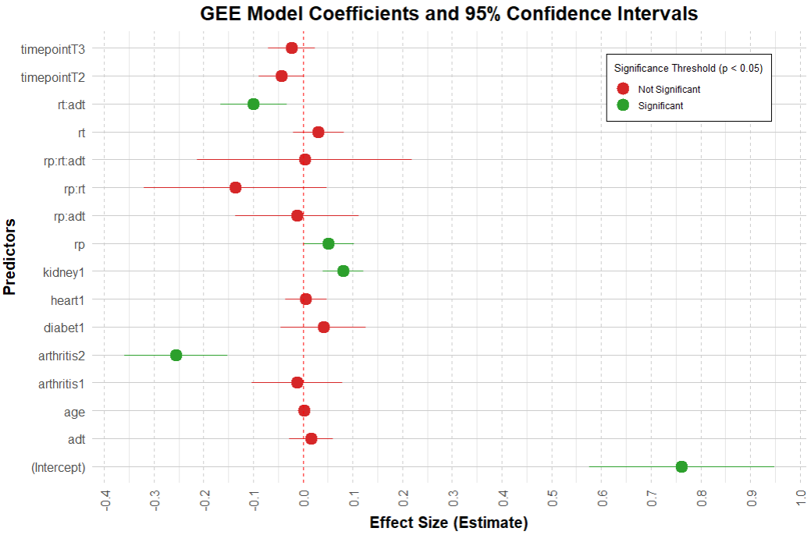
GEE Model
model <- geeglm( eqtot ~ rp * rt * adt + age + timepoint + diabet + kidney + heart + arthritis, id = ptid,
corstr = “exchangeable”)
Method: Exchangeable correlation
Uses clustering by patient ID.
Correlation parameter (alpha) = 0
No detectable correlation between repeated measures (each patient timepoint independent).
426 clusters
Key assumptions:
The effect of the variables on EQTOT is constant from T1-T2, T2-T3, T1-T3.
Scale parameter = 0.0208.
Figure 1: Model Coefficient Plot

Slide 10
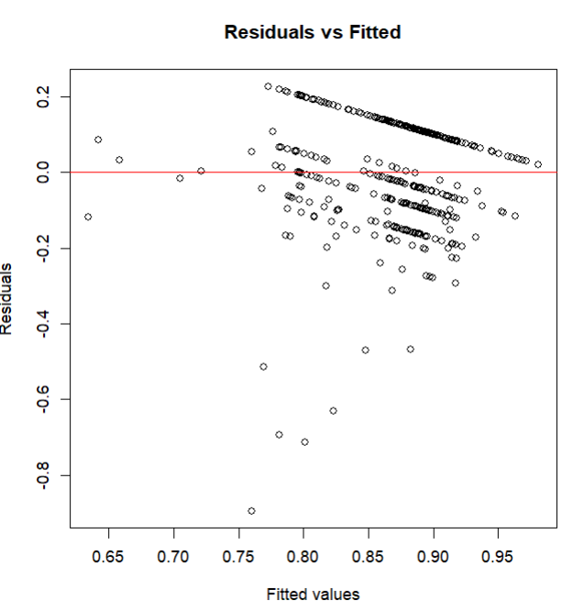
For GEE Model

Slide 11
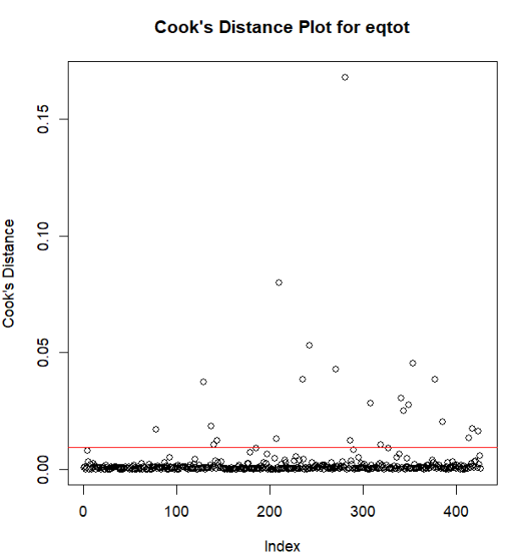
Used to make a second
Mixed-model without
Influential points

Slide 12
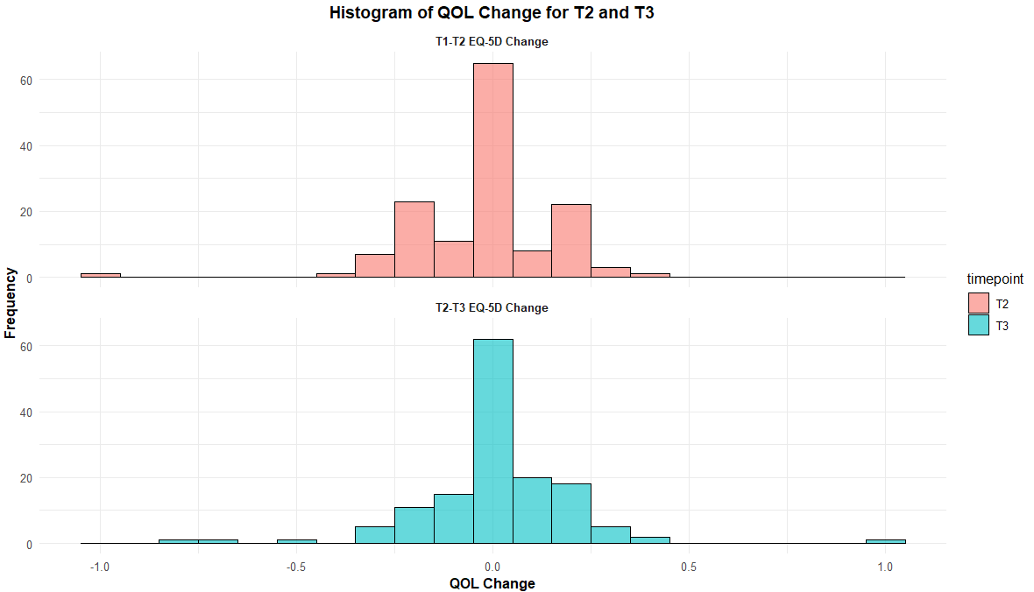
Histogram of the EQ-5D changes for T2 and T3. Kruskal-Wallis was still performed due to difference in variance shown in Levene’s Test.

